Slide 1

Easiest programming language
one should try

Slide 2
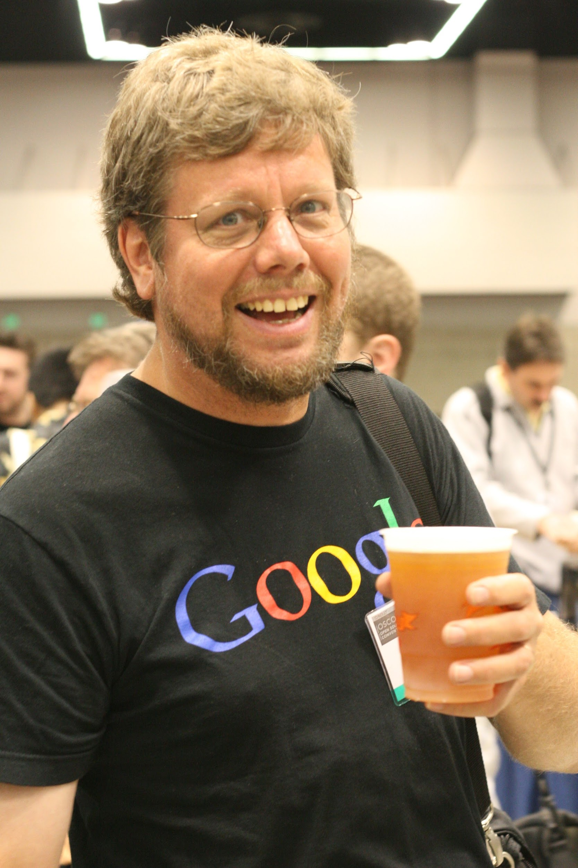

History
Founded by Guido van Rossum in 1991.
It was a Hobby programming project .
It is a successor of ABC language.
Notes:
Created in the week around Christmas.
Named after his Fav. show on BBC Monty Python’s Flying Circus

Slide 3
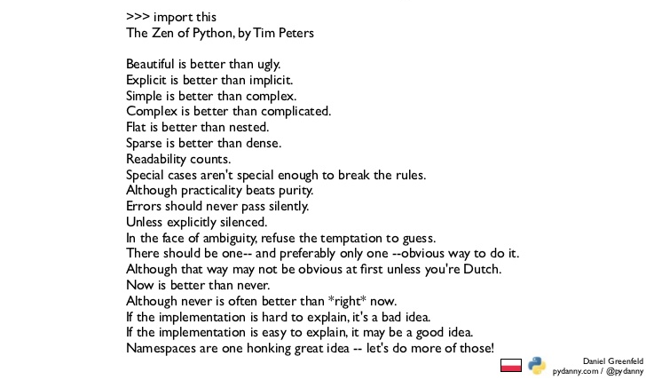
Interesting Facts
There is an poem on python called “Zen of Python”
Notes:
This poem states the guiding principles for writing programs, which were implemented by python.

Slide 4

Interesting Facts
2. ‘Python’ was named after creators favourite show ‘Monty Python’s Flying Circus ’
3. You can define Infinity in Python.
4. Python is one of the official languages at Google.
5. Python was used to stimulate the image of Black Hole!
Notes:
You can define it but using x=float(‘Inf’) and x=float(‘-Inf’)
Google search and Youtube is powered by python

Slide 5
Why Python?
According to StackOverflow Survey 47.7% developers use python, Take me to survey
But Why is it so?

Slide 6
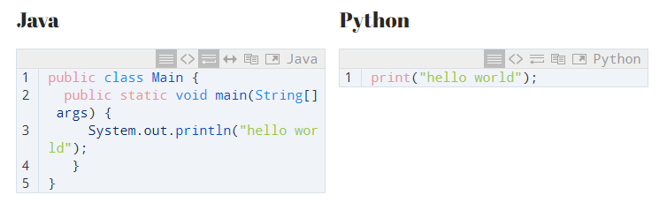
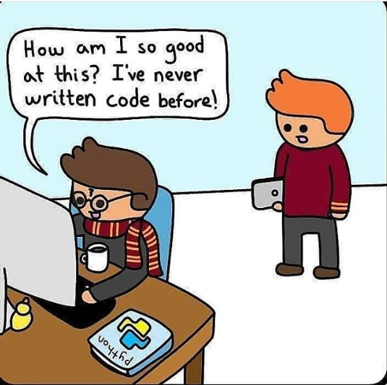
Python is more like English
Increases Code Readability, Understandability
And the Best Language to learn coding for beginners.
Notes:
Due to which programmer can focus only on logic of the program rather than on the syntax of the language.

Slide 7
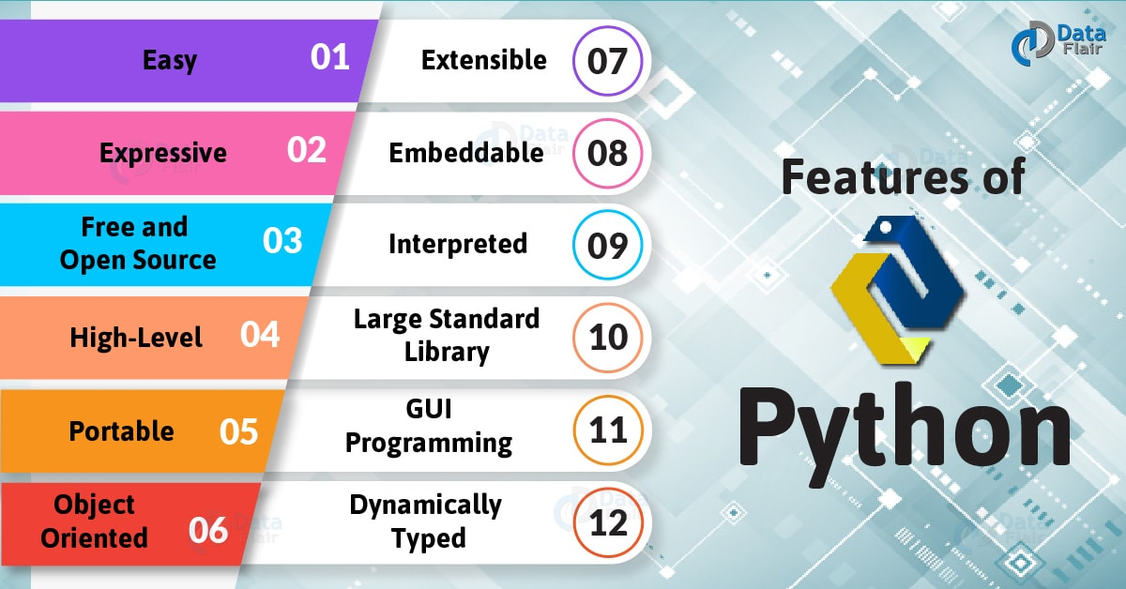
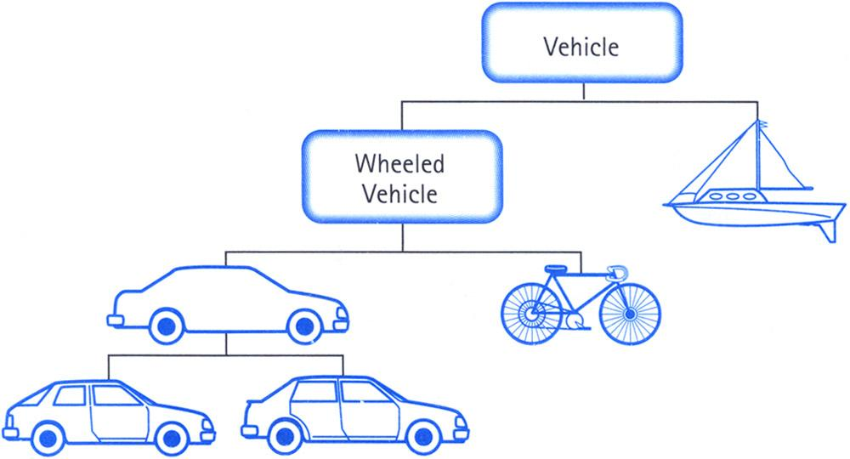
Notes:
Expressive and easy because of its redability
Portable: Run on all os platforms
Object Oriented:
Extensible: C/c++ and java codes in python for speed and productivity
Embeddable : C/C++/Java/other (main code) can embed python in the software

Slide 8
What can you build with Python
1. Web Development
2. Scientific & Numeric Calculations
3. Artificial Intelligence, Machine learning
4. Scripting
5. Data Analysis
6. Game Development
7. Build GUI Applications
8. Program embedded devices
9.

Slide 9
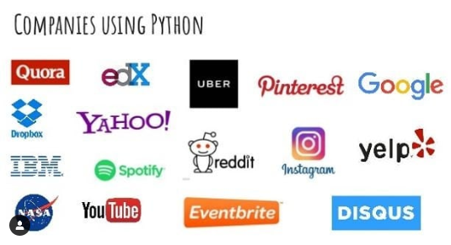
Some Applications Build by python

Slide 10
Learning Sources
1. Youtube Channels & Blogspots
2. Official Documentation
3. Udemy
4. A Youtube Video
Books to prefer:
Learn Python 3 The Hard Way
Python Crash Course
Head First Python
Think Python

Slide 11
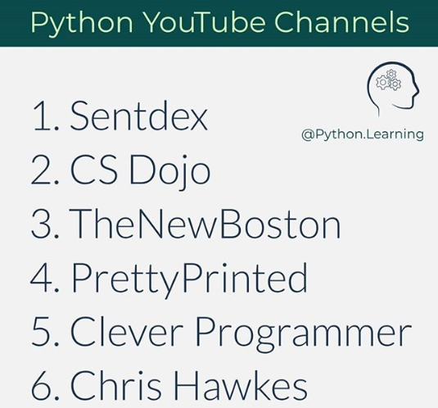
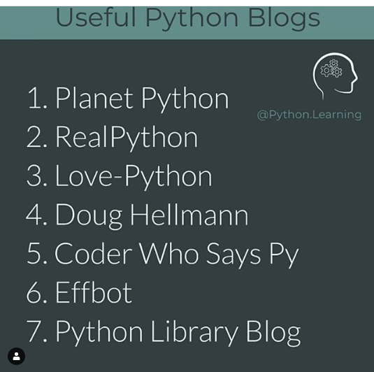

Slide 12
Disadvantage of Python
1. Slower
2. High Memory Consumption
3. Hard Debugging

